Slide 1




TAMILNADU - VIRUDHUNAGAR
MEGA INTEGRATED TEXTILE PARK
Master Developer
AMELL - SPV PARTNERS
A “Capex Free” Integrated Textile Business Hub

Slide 2






TAMILNADU MEGA INTEGRATED TEXTILE PARK
Total Land
: 1250 Acres
Project overview
36 MONTHS ROI
95% EFFICIENCY
Location
: Virudhunagar Dt., Tamilnadu
Sea Port - Tuticorin
: 100 km
Airport - Tuticorin
:110 km

Slide 3
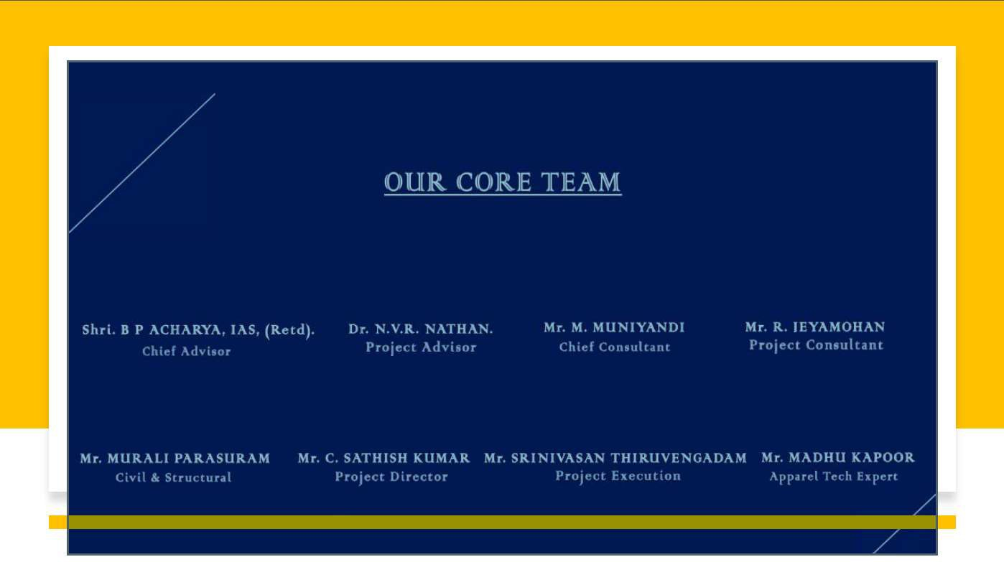


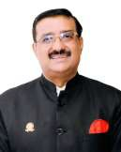
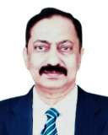
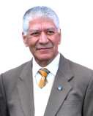
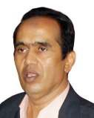




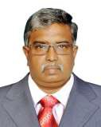
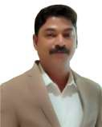
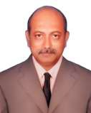


Slide 4








Project High Lights
Economies of scale and enhanced competitiveness.
World Class Integrated infrastructure and logistics support.
Access to a skilled
workforce.
Self Sufficient Renewable Energy @ Less than Rs 4 / Unit
Proximity to raw material suppliers and markets.
Global Technology
Partners
Customized financial assistance programs.
Subsidized land acquisition and lease options.
Simplified regulatory procedures.

Slide 5

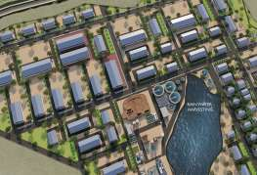
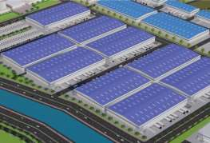
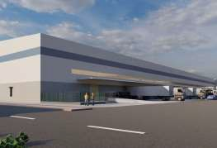

Project Highlights
Manufacturers investment is only 10 % of the Project cost.
Capital cost will be partly subsidised and Partly lease rental
A Perfect Business Ecosystem with 24 x 7 Raw materials availability
Quality of Life - Comfort & Convenient
Skilled Workforce from ”Walk to Work” Integrated (25000) Housing Township &
Dormitory for 25,000 People.
25 to 35 MLD CETP Infrastructure with ZLD or Marine Outfall under BOOT
Government Support and Incentives &Regulatory Environment
Multi Fold Growth Potential
Complete Compliances management &Statutory Clearances under one roof

Slide 6
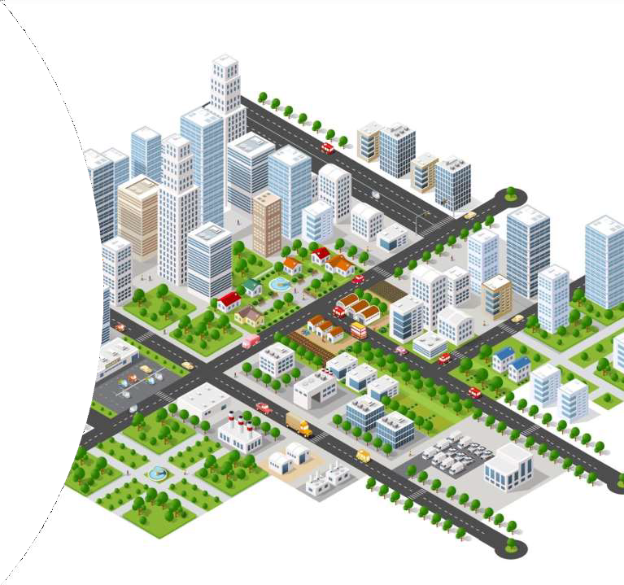

ClusterTheme
Brief about Apparel Cluster :
Plug & Play Factory Building for Garment and allied Product Manufacturerson ownership or Lease Model with exit option.
Exclusive zone for large Manufacturers – Buy or Lease with Customized Infrastructure.
Exclusive zone for – MSME Units
All buildings are asper Factory norms & Global compliances

Slide 7
Common Effluent Treatment Plant – ( CETP ) – MODEL
CETP CAPACITY - 35 to 40 MLD
MODEL - Technology Transfer & Build - own - Operate & Transfer ( BOOT )
SYETEM VALUE / COST - Rs. 450 to 500 crores ( INR ) - Includes Civil , MEP & System.
TECHNOLOGY PARTNER - Scope of Work:
Investing in System / Equipment’s , Design , Installation & Commissioning of the entire system.
Providing Training to Operate & Maintenance (Either by own team or Third Party )
3. Providing documentation & Report of the system ( on Signing NDA )

Slide 8
MASTER DEVELOPER – Scope of Work :
Providing Technical Data’s , Specification’s of independent manufacturer’s & detailed drawing’s of the Project.
Providing Space for the CETP & Investing , executing associated Civil & MEP works to integrate the system.
Co-ordinating & Supporting in documentation & submission of documents to the concerned department’s for statutory approval’s.
4. Providing assistance in execution & commissioning .
Structuring Investment & Revenue Model’s. ( Based on the Investment ratio )
Co-ordinating with Government bodies to get Grant’s & Subsidies & transfer the commercial benefits to Technology partner proportionately.

Slide 9
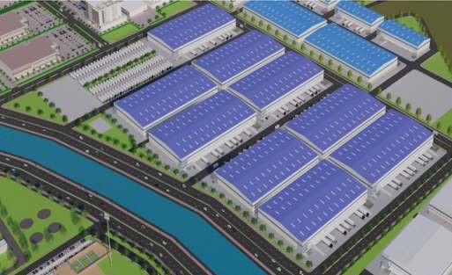
APPAREL & HOME TEXTILE ZONE
ANCILLARY ZONE
PROCESSING ZONE
WAREHOUSE ZONE
AMENITIES ZONE
CRITICAL INFRA ZONE
HOUSING TOWNSHIP ZONE
Zoning
Free Trade warehousing Zone – FTWZ – as per Gol Policy
Standard Warehouse Buildings – Ready to use Facilities Auditing & Compliances Mapping And Management Centre
Textile Technology & Business Incubation Centre
Design Incubation / R & D / Fashion Designers Lounge / Villas Co-working space & office park
Centre of Excellence for Apparel, Home Textile & Processing
International Accredited Labs& Quality Assurance Centre Global Brand Buyers Regional Office

Slide 10
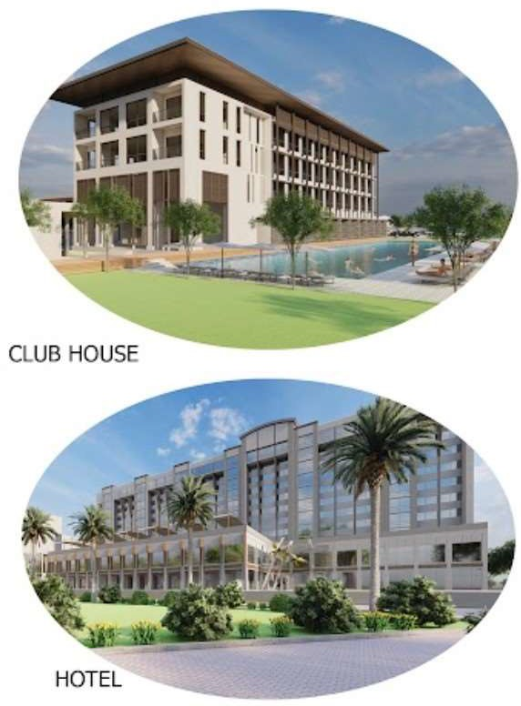
SpecialAmenities
Integrated Training & fashion Institute
Fashion Designer Villas with customised Design Studio
Health Care & Fitness Centre
International Quality Convention / Trade Centre Star Hotel with Service Apartments / Condominiums
Food Park, Sports Club with E.V Charging & Fuel Station Hyper Market,Multipurpose Convention &Expo Hall Premium Restrooms & Dormitories
Centre For O & M Of Machineries & Services
Library / Resource centre for Books, Magazines , Materials

Slide 11
Sl No | Name Of the Facility | Total Area Required 1250 Acres
Factories Zone Area in Acres
1 | Knitting Zone | 15
2 | Weaving Zone | 20
3 | Yarn Preparation And Fabrics Finishing Zone | 20
4 | Apparel Zone | 250
5 | Garment Finishing Zone | 10
6 | Value Addition Zone | 10
7 | Printing And Processing Zone | 200
8 | Technical Textiles Zone | 25
9 | High Value Product Zone | 10
10 | Accessories Zone | 5
11 | Textile Packaging Material Zone | 5
 | Sub Total Area | 570

Slide 12
Common Facilities Zone
12 | Integrated Training Centre & Fashion Institute | 5
13 | Dormitories For 5000Staff & Executives | 5
14 | Dormitories For 20,000Workers | 20
15 | Service Apartments For Entrepreneurs And Imp Visitors | 3
16 | Multipurpose Convention / Expo Hall | 6
17 | International Accredited Labs & Quality Assurance Centre | 2
18 | FTW Area , Logistics & Transportation Infrastructure, Railway Dry Port | 100
19 | Textile Technology & Business Incubation Centre | 3
20 | Centre of Excellence For Apparel & Processing * | 10
21 | Design Incubation / R & D / Fashion Designers Lounge / Villas | 5
22 | TPA Auditing & Compliances Mapping And Management Centre | 1
23 | Health Care Centre / Fitness Centre | 1
24 | E Vehicles Rental , Parking And Charging Stations | 5
25 | Recreation Centre, Club House | 1
26 | Food Plaza, Star Hotel , Sports Club, Hyper Market | 2
27 | Petrol , Diesel & Gas Filling Station | 1
28 | Centre For O & M Of Machineries & Services | 1
29 | International & National - Buyer –Seller Lounge / Trade Centre | 2
30 | Library For Books, Magazines, Materials, Fabrics, Accessories | 3
31 | Admin, Finance, HR & Marketing Office | 1
32 | Communication And IT Centre With Business Support Services , Market Intelligence | 2
 | Sub Total Area | 179

Slide 13
Common Infrastructure
33 | Common Effluent Treatment Plant+ Solid Waste Management - 50 MLD | 70
34 | Sewage Treatment Plant | 10
35 | Internal & Approach Roads & SWD | 150
36 | Power Station | 5
37 | Rain Water Harvesting | 10
38 | Water Purifying , Storage And Supply Systems | 5
39 | Helipad | 2
40 | Open Green Area With Miyawaki Forest | 75
41 | Cotton, Polyester, Plastic, Metal Collection, Storage & Recycle Centre | 10
 | Sub Total Area | 337

Slide 14


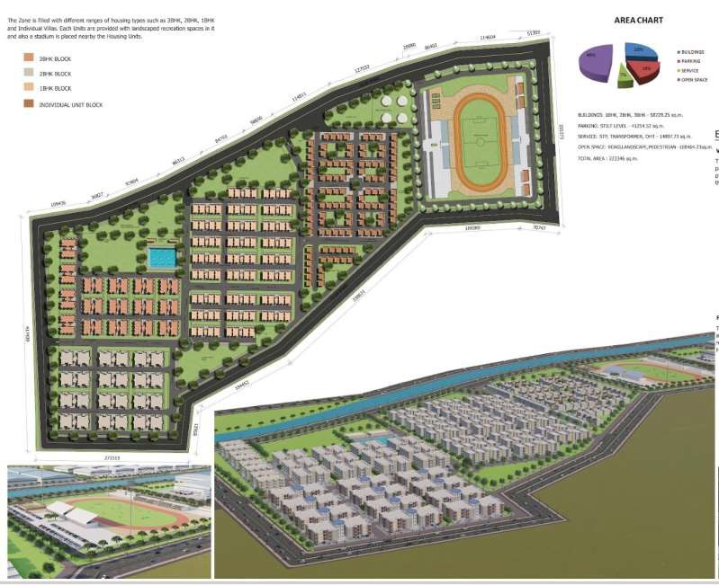

Integrated Affordable Housing Township For 25000 Families with Following Facilities in 150 ACRES
Health Care Centre, School , Training Centre , Solar, Pure Water, STP
Old Age Home, Creche, Play Area, Community Hall & Amphi Theatre,
Community Kitchen, Community Workplace & Vegetable Garden on Roof

Slide 15
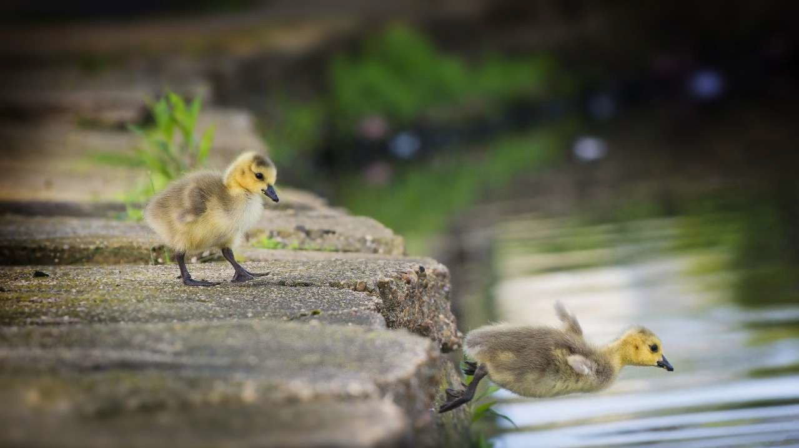

I want to expand without risk myself
from new investment
I want to move to new better location
WHY DO YOU NEED TO BEIN THIS MEGA PROJECT?
I want to
venture
new
product line

Slide 16



Amell Industrial Ventures India Pvt. Ltd.
MASTER DEVELOPER
ARCHITECT
PMC
EP C
Design Consultants

Slide 17






CONFIDERATION PARTNER
MEDIA & MAGAZINE PARTNER
CoE & TRAINING PARTNER

Slide 18





SY CP
T N FMA
ASSOCIATION PARTNERS

Slide 19

FOR FURTHER DETAILS CONTACT
Dr. N.V.R.NATHAN
R. JEYAMOHAN
- 84518 08979
- 97900 38383
C. SATISH KUMAR - 84316 94670
Amell Industrial Ventures (India) Pvt Ltd., Bengaluru & Chennai.
Email :
sathishkumar.c @ amellindustrialventures.com
jm@iciprojects.in

Slide 20


