Slide 1
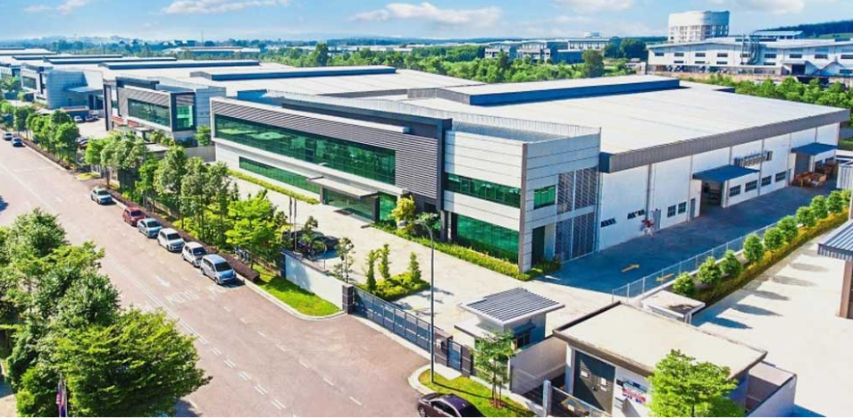
JAPANESE INDUSTRIAL TOWNSHIP (JIT)

Slide 2
JAPANESE INDUSTRIAL TOWNSHIP ( JIT ) - KARNATAKA - INDIA
JIT is an exclusive Japanese Industrial Hub , providing customised Infrastructure with 100% Plug & Play facility, first of its kind for Japanese Manufacturers & Ancillary Units at Vasantha Narasapura - Tumkur Road which comes under JICA Corridor.
JIT is an JETRO initiative in association with KIADB, AMELL has a master developer will purchase the land jointly with SPV partners, from KIADB which is already allocated for JIT.
SPV will Register in KIADB Portal & will submit E.O.I proposal to develop the JIT . AMELL SPV will develop customised infrastructure to each clients & lease to potential Japanese Clients with exit options.
AMELL will develop JIT has an world class infrastructure by incorporating latest Technologies like BIM, TEKLA & DGPS Drone Survey & Construction monitoring & will present the model to potential clients virtually & on approval from client the execution of the same will be done.
( SEEING IS BELIEVING )

Slide 3
The Project is planned in 3 Phases as per the KIADB Layout, which can be increased based on the client inflowing requirements.
AMELL INDUSTRIAL VENTURES (INDIA) PVT .LTD with SPV & Consortium partner’s will develop the entire JIT with own investment & International project funds, which will be a fast track project.
AMPLUS SOLAR - (A Member of PETRONAS & GENTARI GROUP - MALAYSIA ) has already expressed their interest to Invest in the Solar Plant/Park exclusively for JIT, which will be self Sufficient to meet out the required Power to the industries in JIT.
AMELL - SPV will design & construct BTS/Customised Manufacturing Plants as per the client requirements & Specifications, which includes Civil, Steel Structures ( PEB ) , Fire Hydrant Systems, BMS, MEP, HVAC, STP & ETP ,Utilities, Landscaping , Road works & Rain Water Harvesting, ETC,..

Slide 4
The Infrastructure work will be developed / executed as per the Final approved drawing by the client’s & will be handed over in stipulated timeline to the clients has a 100% plug & play manufacturing unit.
The completed project for particular company / entity will be handed over for which the clients has signed a Lease agreement to occupy & operate their Industries. The client may seek Master developer ( AMELL ) for EXIT on settling the Investment made after 4th year or within 10 years to take the ownership of the premises ( Land , Building & amenities.
Apart from Infrastructure provided by the AMELL SPV, the clients will invest themselves for the Capital Equipment's & Requirements for which they will have the ownership of those particular items.
The standard period of Lease Agreement will be for 10 years between AMELL-SPV & Client’s . During this period the client can propose for Exit option to takeover the ownership. The ultimate agenda is to reduce the Capital expenditure & hassle free business activity to the Manufacturer’s / End user’s.

Slide 5
Total Land Area - Phase 1 = 101.30 Acres = 4,412,628 Sq.ft.
Total Land Area - Phase 2 = 120 Acres = 5,227,200 Sq.ft
Master Developer - AMELL Industrial Ventures (India) Pvt.Ltd. - Bangalore
Project Architect - RSP Design Consultants (India) Pvt.Ltd. - Bangalore
Technology Partner’s – AMPLUS SOLAR ( A member of GENTARI Group – Malaysia)
Industrial Power Tariff – Below Rs.4.10/unit.
Project Management Consultants – Takenaka & Colliers
Effluent Treatment Plant – Bluestem Bhd Sdn – Malaysia
USP – 60% lesser cost comparing to Traditional System.
80% faster processing time with 0% slag Spillage

Slide 6







Dock leveler & Fire rated Rolling shutters
Concept Design,
Liasoining , BIM & TEKLA, Civil & Structural Works.
(Utkarsh Infra projects)
www.fercoshutters.com
Architects & Design Consultants.
Material storage, handling & Facility management.
www.rspindia.net
www.uds.in
Amplus Solor (Asia’s leading distributed energy Company)
Project Management Consultant
www.colliers.com
Mechanical Electrical & Plumbing
( MEP )
www.auroflux.com

Slide 7
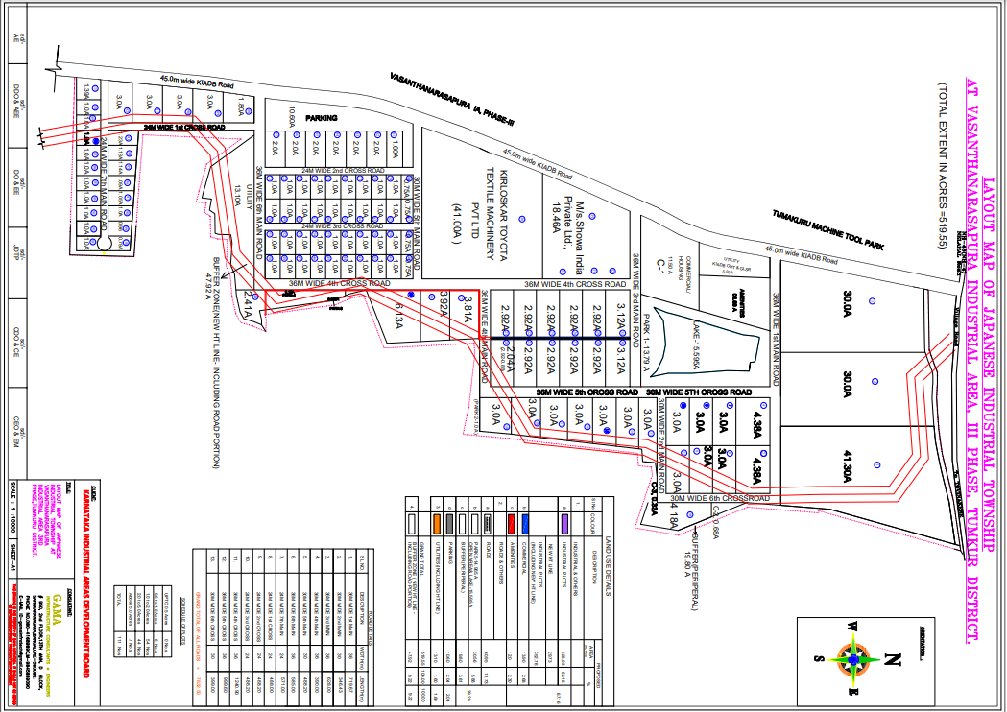

Slide 8
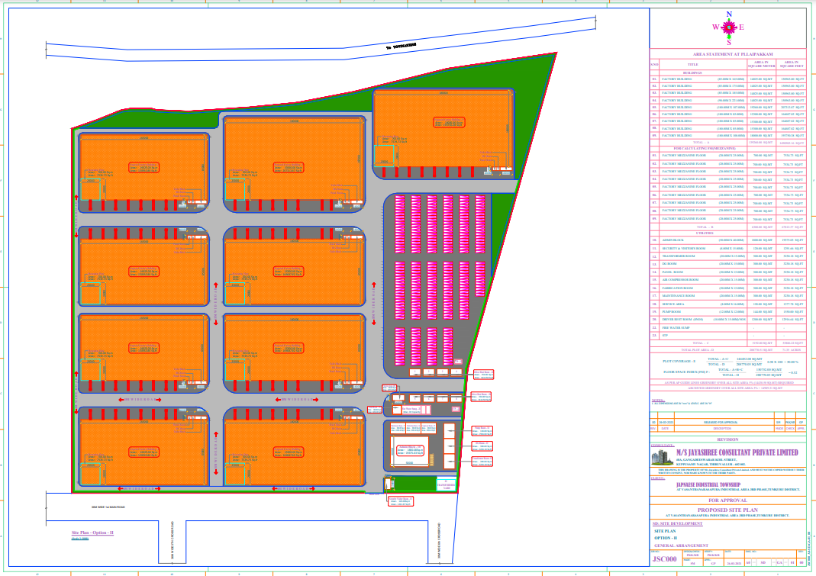

Slide 9
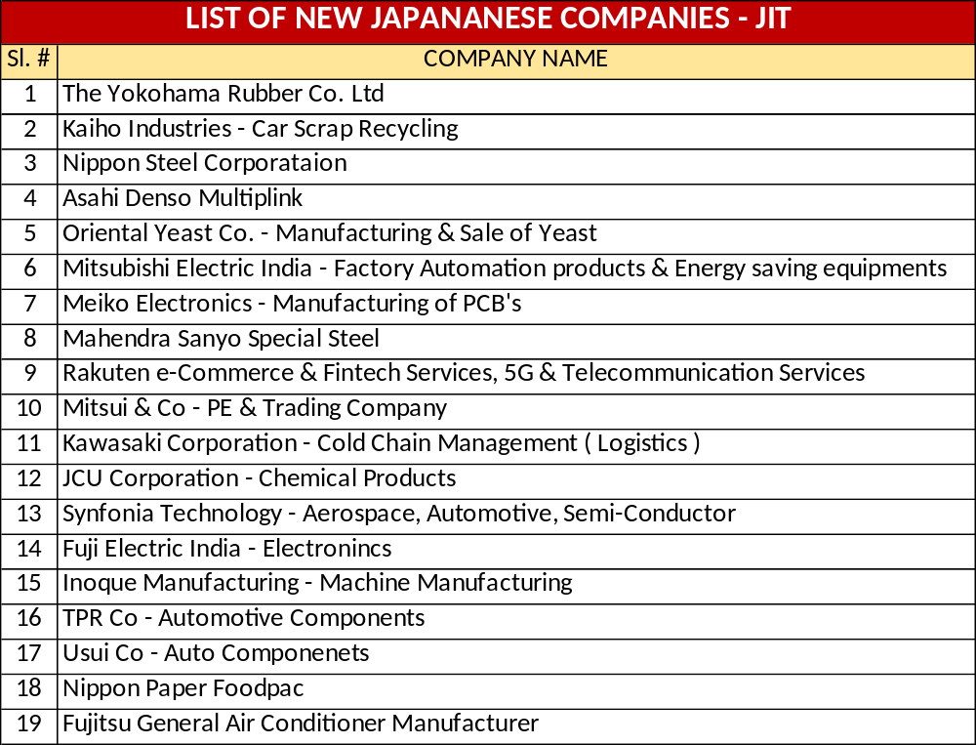

Slide 10
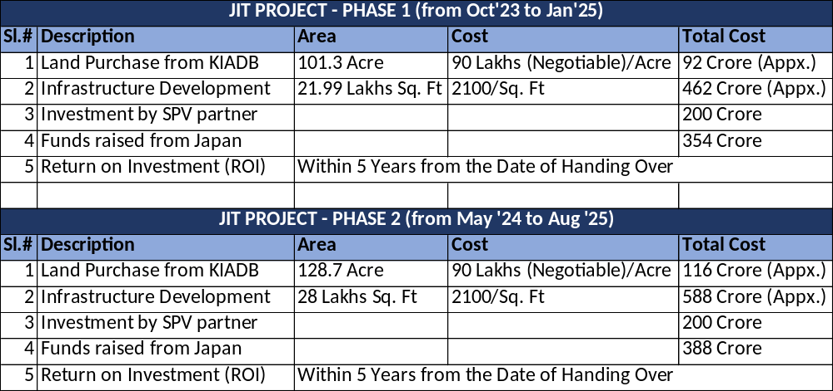

Slide 11
