Slide 1

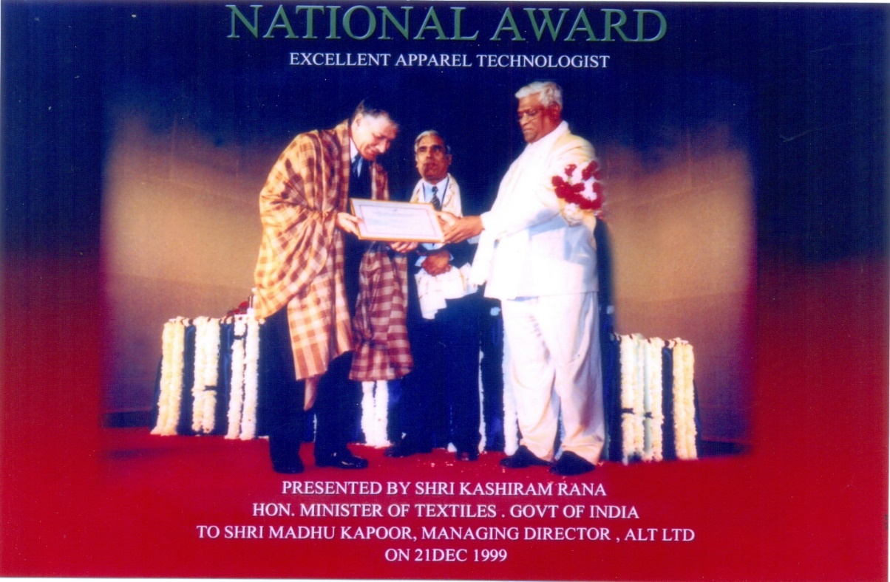
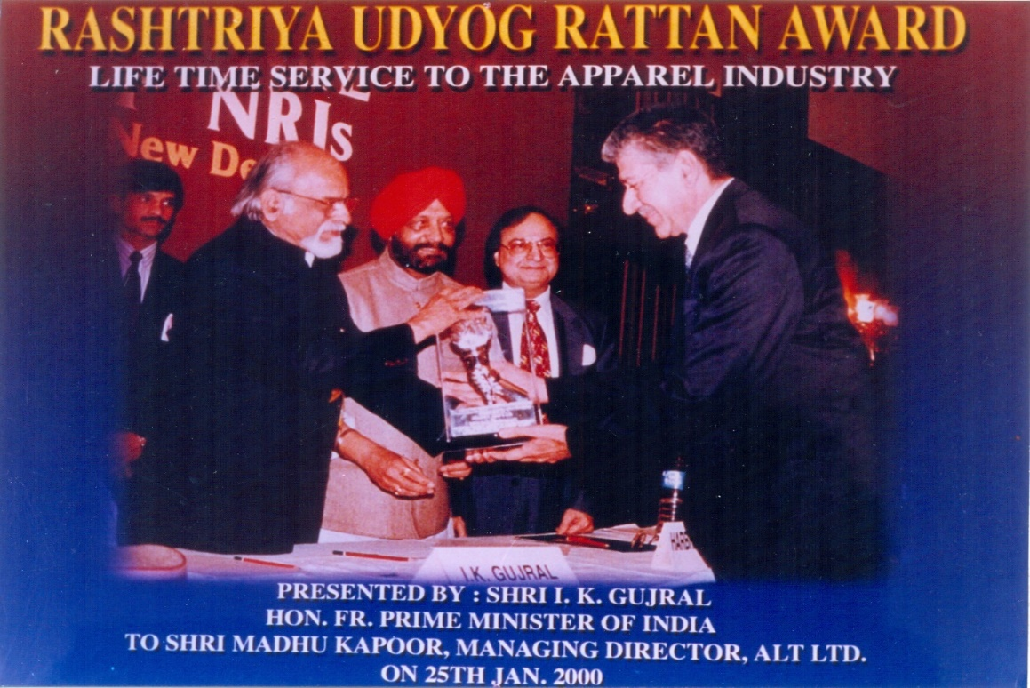
AWARDS
NATIONAL AWARD
EXCELLENT APPAREL TECHNOLOGIST
Presented by Shri Kashiram Rana
Hon.Minister of Textiles, Govt., of INDIA
To Shri Madhu Kapoor, Managing Director,
ALT LTD ON 21 DEC 1999
RASHTRIYA UDYOG RATTAN AWARD
LIFE TIME SERVICE TO THE APPAREL INDUSTRY
Presented by Shri I.K.Gujral
Hon.FR.Prime Minister of INDIA
To Shri Madhu Kapoor, Managing Director,
ALT LTD ON 25th JAN 2000

Slide 2
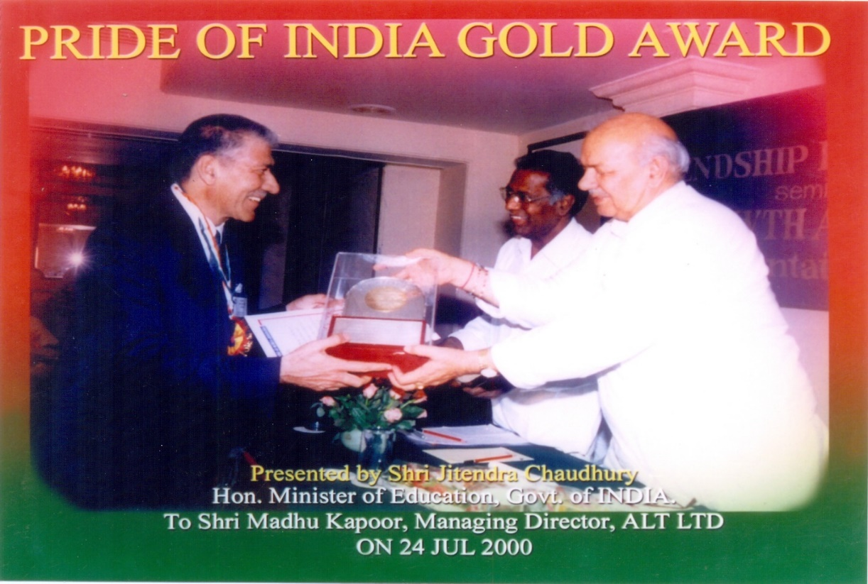
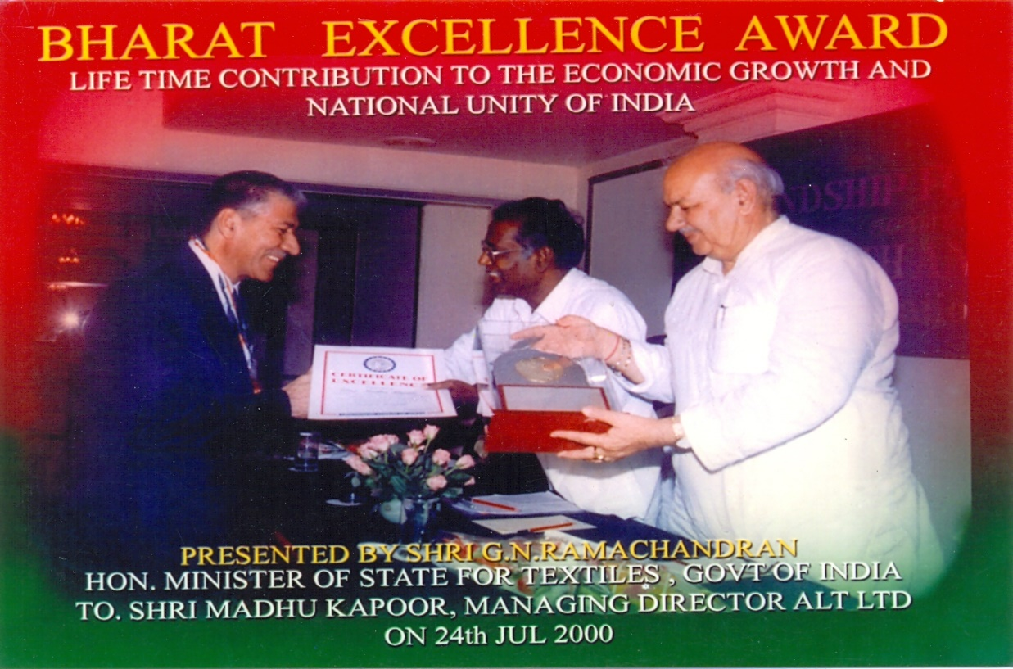
AWARDS
PRIDE OF INDIA GOLD AWARD
Presented by Shri Jitendra Chaudhary
Hon.Minister of Education, Govt of INDIA
To Shri Madhu Kapoor, Managing Director,
ALT LTD ON 24 JULY 2000
BHARAT EXCELLENCE AWARD
Presented by Shri G. N RAMACHANDRAN
Hon.Minister of Textiles, Govt of INDIA
To Shri Madhu Kapoor, Managing Director,
ALT LTD ON 24 JULY 2000

Slide 3
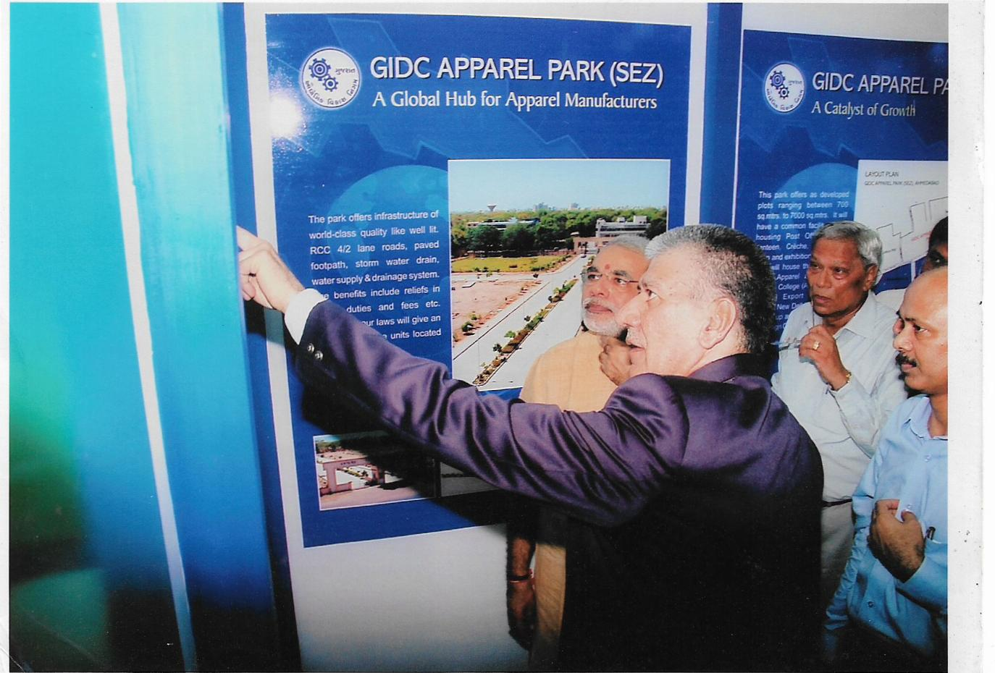

ALT SKILL DEVELOPMENT PROGRAMME
Inauguration of ALT Training College Ahmedabad
by Shri Narendra Bhai Modi
Honorable Prime Minister of India
Message from Honorable Prime Minister
MAKE INDIA THE CLOTHIER OF THE WORLD
TEAM
Wishes to assure our beloved Prime Minister that we will
work tirelessly to fulfill his dream.

